Slide 1
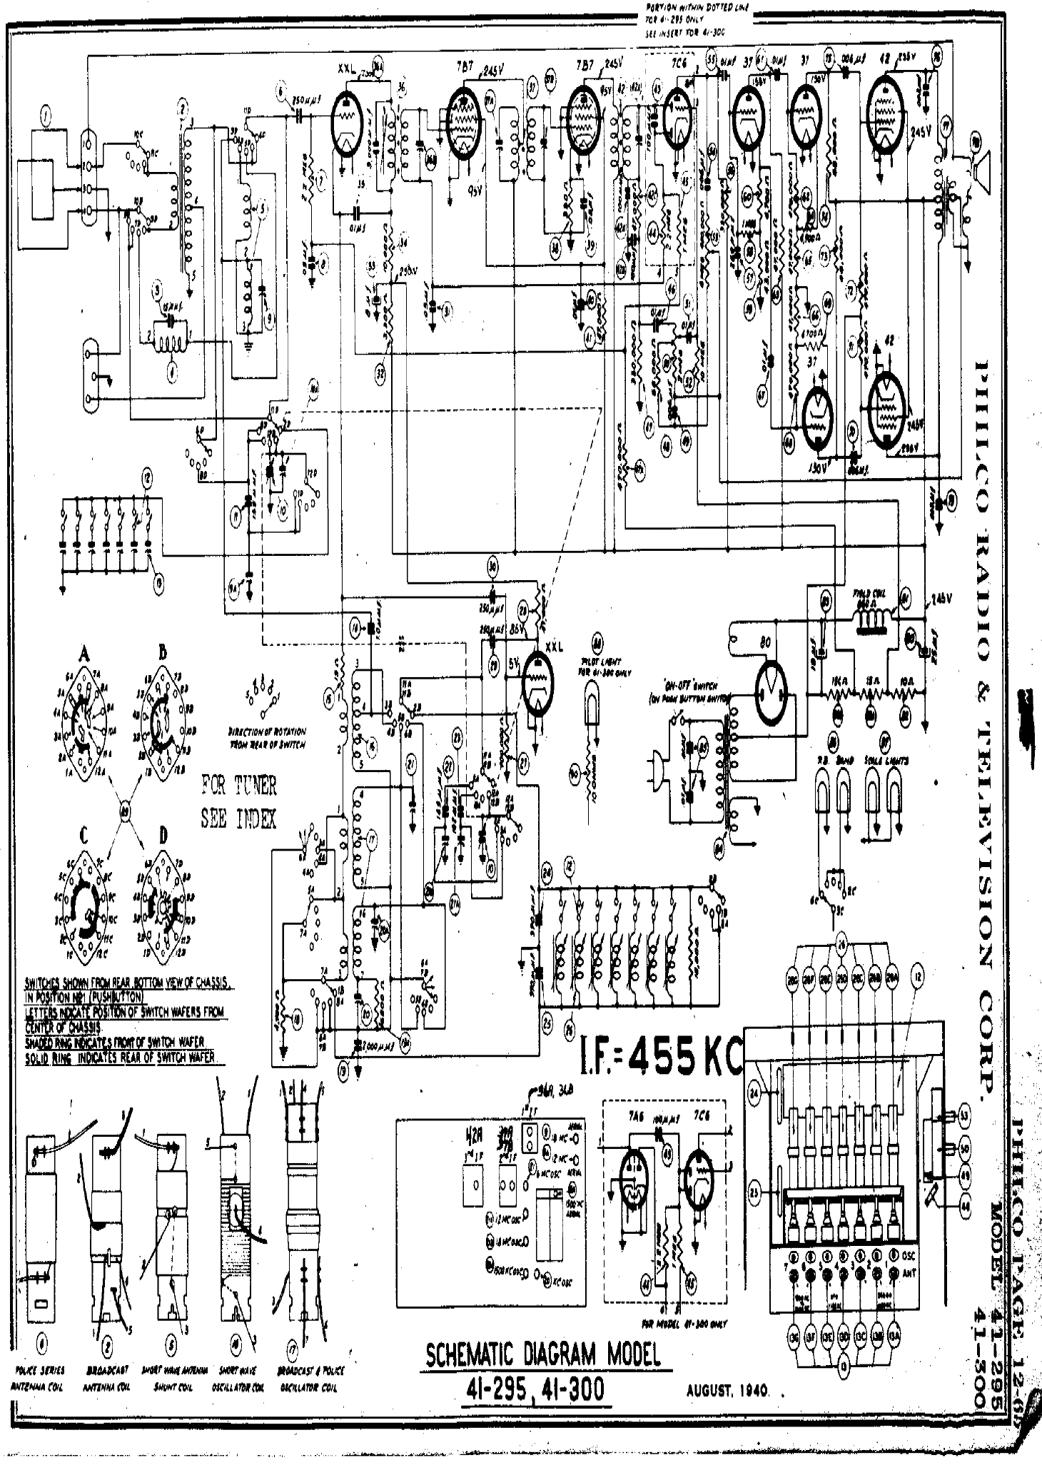
PORTION WITHIN DOTTED LINE
FOR 41-295 ONLY
SEE INSERT FOR 41-300
XXL
200V
36A
7B7
245V
37B
7B7
245V
7C6
2
55
.01 mfd
37
61
.01 mfd
37
75
.006 MFD
42
235 V
76
1
2
6
250 pF
36
37A
37
95V
42
42A
43
3
155 V
150 V
.003 mfd
1
10C
3
3D
11D
6D
100 pF
74
77
4D
78
1
11C
1
5D
3,000 pF
36B
54
68 kΩ
2
1
7
PORTION WITHIN DOTTED LINE
FOR 41-295 ONLY
SEE INSERT FOR 41-300
45
56
62
3
10D
4
2.2 MΩ
35
95V
330Ω
.05 mfd
100 pF
42C
.006 mfd
60
330 kΩ
235 v
76
61
.006 mfd
.01 mfd
37
37
75
42
4
5
47,000 Ω
9D
2
XXL 200V
36A
7B7 245V
37B
7B7 245V
7C6
55
.01mfd
1 MΩ
64
7D
.01 mfd
6
36
37
42A
42A
150 v
4 MΩ 400 k͎Ω
43 kΩ 4700 Ω
42
43
44
2.2 MΩ
1 MΩ
250 pF
37A
95V
61
53
.003 mfd
4700 Ω
2
34
38
39
73
2
3
10,000 Ω
250 pF
58
77
8
3
100pF
47 kΩ
65
68 kΩ
10C
3k pF
100 pF
245 v
5
1
2
3
4
.05 mfd
11C
33
250V
36B
42B
54
4
5
68,000 Ω
57
78
3
1
2.2 MΩ
.006 mfd
46
470 kΩ 47 kΩ 47 kΩ 470 kΩ
72
1
7
35
40
45
60
63
15pF
8 MFD
51
69
4
.05 mfd
42C
62
59
.1 mfd
470,000 Ω
31
330Ω
100 pF
4700 Ω
66
9
5
95V
.05 mfd
47,000 Ω
.01 mfd
74
3300 Ω
64
470 kΩ 470 kΩ
1
3
.01 mfd
2.2 MΩ
1 MΩ
.01 mfd
2
42A
44
1MΩ
2
34
38
41
53
4700 Ω
4700 Ω
42
2
.05 mfd
10kΩ
39
4 MΩ 400,000 Ω
58
73
71
47,000 Ω
65
68,000 Ω
8
33
100
pF
47,000 Ω
37
250V
42B
43,000 Ω
5
330 kΩ
57
50
2 MΩ
.01 mfd
4
3
32
46
51
47,000 Ω
10 MΩ
72
.1 mfd
68 kΩ
63
69
470,000 Ω
10A
15 pF
8 mfd
31
.01 mfd
59
52
2
1
3
9
3300 Ω
.05 mfd
40
47k Ω
.006 mfd
66
42
67
4700 Ω
71
11D
2D
330,000Ω
2 MΩ
.01 MFD
37
470,000 Ω
245 V
6D
8D
32
68,000Ω
10 MΩ
47
70
12D
4
470,000 Ω
10A
41
.006 mfd
48
49
68
235 V
12
8D
12D
6D
47
470 kΩ
47X
67
70
245 V
130 V
.006 mfd
155pF
1D
12
8D
12D
470,000 Ω
48
52
68
130 V
.006 mfd
235 V
.003 mfd
79
11
10
50
155 pF
10
49
79
11
.003 mfd
13
9A
13
9A
30
FIELD COIL
860 Ω
FIELD COIL
860 Ω
81
245 V
250 pF
250 pF
28
83
81
245 V
83
14
1 pF
85 V
47,000 Ω
88
A
B
47,000 Ω
80
80
XXL
18 MFD
25 mfd
PILOT LIGHT
FOR 41-300 ONLY
A
B
3
5 V
XXL
88
80
80
6A
7A
6B
7B
3
15 Ω
29
PILOT
15 Ω
10 Ω
8A
8B
4
2
“ON-OFF” SWITCH
(ON PUSH BUTTON SWITCH)
115 Ω
25 mfd
5A
5B
5
1
15
PILOT LIGHT
FOR 41-300 ONLY
18 mfd
6A
7A
6B
7B
4
3
4A
9A
4B
9B
1
4
82B
82A
82
150 Ω
15 Ω
10 Ω
5A
8A
5B
8B
2
10A
10B
DIRECTION OF ROTATION
FROM REAR OF SWITCH
“ON-OFF” SWITCH
(ON PUSH BUTTON SWITCH)
3A
3B
23
9A
9B
5
1
11A
2B
11B
16
100,000 Ω
85
86
87
4A
4B
2A
12A
1B
12B
5
21
22
27
10 Ω
RB BAND SCALE LIGHTS
82B
82A
82
1A
FOR TUNER
SEE INDEX
9A
90
.01 mfd .01 mfd
10A
DIRECTION OF ROTATION
FROM REAR OF SWITCH
4
12A
12B
3A
3B
10B
1
145 pF
12A
12B
85
86
87
162 pF
11B
C
89
D
10A
2A
.01 mfd .01 mfd
RB BAND SCALE LIGHTS
2A
11A
2B
12B
3A
17
3A
90
10 Ω
84
1A
12A
1B
6C
7C
6D
7D
6A
4A
10
24
12
5C
8C
5D
8D
4
4A
5
2B
FOR TUNER
SEE INDEX
9C
1
5A
2
21B
2C
89
4C
4D
9D
6
21A
370 pF
1B
8A
6C
3C
C
D
3C
10C
3D
10D
17
7A
20A
2C
11C
2D
11D
26
1C
3A
12D
10,000 Ω
84
6D
7D
12C
1D
7A
6A
7B
6C
7C
6A
4A
3
7
370 pF
26B
12
26E
26C
26A
SWITCHES SHOWN FROM REAR BOTTOM VIEW OF CHASSIS
IN POSITION NO.1 (PUSHBUTTON)
LETTER INDICATE POSITION OF SWITCH WAFERS FROM
CENTER OF CHASSIS
SHADED RING INDICATES FRONT OF SWITCH WAFER
SOLID RING INDICATES READ OF SWITCH WAFER
12
26G
26D
5C
8C
5D
8D
4A
1B
8A
24
26F
2B
SWITCHES
5
6800 Ω
4B
5A
2
4700 Ω
20
5B
4C
9C
4D
9D
6
18
6A
7B
2,000 pF
19X
25
26
1B
6C
3C
2C
3C
10C
3D
10D
20A
19
8A
7A
1
2
2
4
5
36A
36B
1ST IF
26
2C
11C
2D
11D
1
6A
7B
370 pF 370 pF
7A6 7C6
24
10,000 Ω
53
1C
12B
1D
12D
1
3
1
100 pF
2
7A
3
7
37A
42A 37B
3RD IF 2ND IF
9
AERIAL
26D
26C
12
5
9 M.C.
1
26F
26E
26B
26A
SWITCHES SHOWN FROM REAR BOTTOM OF CHASSIS
IN POSITION NO.1 (PUSHBUTTON)
LETTER INDICATE POSITION OF SWITCH WAFERS FROM
CENTER OF CHASSIS.
SHADED RING INDICATES FRONT OF SWITCH WAFER
SOLID RING INDICATES REAR OF SWITCH WAFER
1B
8A
12 M.C.
43
50
26G
9A
3
2
20
6800 Ω
5B
4B
21
AERIAL
25
49
4700 Ω
18
25
21A
10A
26
48
6A
7B
2,000 pF
4
19X
21B
12 M.C OSC
18 M.C. OSC
1500 M.C. OSC
1500 KC
AERIAL
2.2 MΩ
2
1 MΩ
1
OSC
ANT
1
4
19
20A
36A
36B
1ST IF
580 KC
OSC
44
7 6 5 4 3 2
2
1
2
4
5
3
20
4
45
24
3
5
7C6
53
5
3
FOR MODEL 41-300 ONLY
1
3
6
7A6
100 pF
13A
1
4
2
5
10
7
13G 13F 13E 13D 13C 13B
1
17
37A
37B
2ND IF
9 MC AERIAL
2
5
POLICE SERIES
ANTENNA COIL
BROADCAST
ANTENNA COIL
SHORT WAVE ANT
SHUNT COIL
SHORT WAVE
OSCILLATOR COIL
BROADCAST 4 POLICE
OSCILLATOR COIL
42A
3RD IF
9
1
13
50
12 MC AERIAL
2
21
9A
43
3
49
6 MC OSC
10A
25
48
4
21A
12 MC OSC
1500 KC
AERIAL
21B
2
2
18 MC OSC
2.2 MΩ
1 MΩ
7
6
5
4
3
2
1
OSC
ANT
4
30A
1500 KC OSC
580 KC OSC
44
45
3
4
5
4
1
2
5
5
3
10
3
17
7
6
SCHEMATIC DIAGRAM MODEL
41-295, 41-300
FOR MODEL 41-300
13G
13F
13E
13D
13C
13B
13A
POLICE SERIES BROADCAST SHORT WAVE ANT SHORT WAVE BRAODCAST 4 POLICE
ANTENNA COIL ANTENNA COIL SHUNT COIL OSCILLATOR COIL OSCILLATOR COIL
SCHE
13

